Slide 1

DRONE HARDWARE
BY KTC HUBLI
Group 1:
1)Huligemma
2)Jevan
3)Ajay
GUIDED BY
MOHAMMAD TAHIR MIRJI
L2 KTC Hubli
ASSIGNMENT FOR
Expert: SABYASACHI B

Slide 2
BASED ON RANGE
•
Very close range drones Close range drones Short range drones
Mid range drones
•
•
•

Slide 3
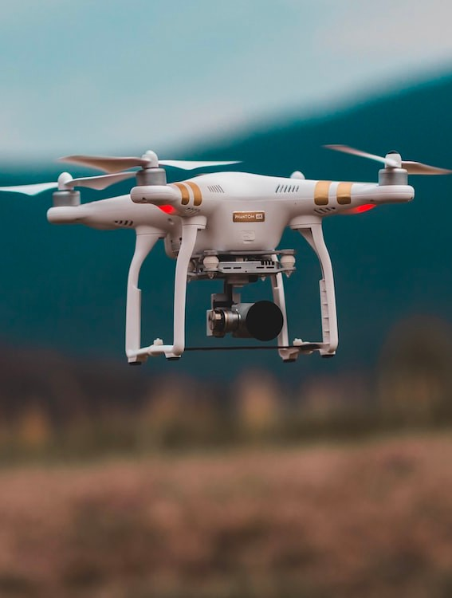
MERITS OF DRONES
Drone technology is safer as it does not requires any human presence physically .A remotely controlled drone can reach nooks and cracks of the places that are impossible for man to visit, and in case of accidents, you will have no human casualties.
It's convenient and effective as it is runs by battery and not fuel, providing some relief to nature.
Drones are really cheaper to maintain as they don't require fueling or other maintenance.
Combat drones can be a major advantage over the enemy during war situation as you will not have any human casualties.

Slide 4
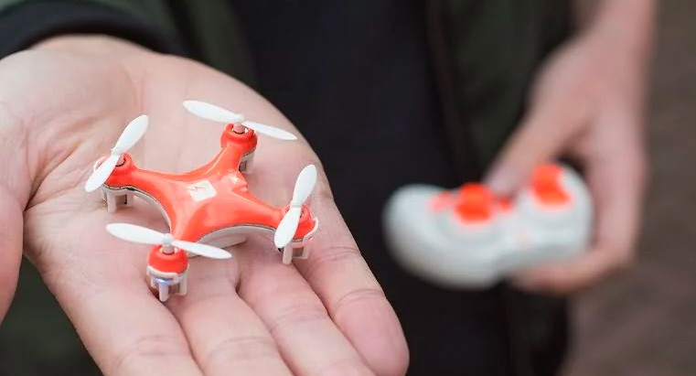
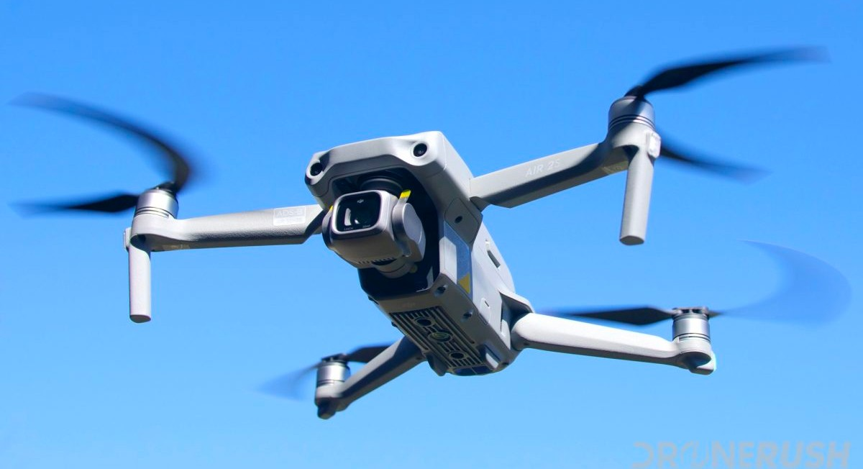
Nano drones
Regular -size
drones

Slide 5
MATERIALS REQUIRED
ARDUINO
WIRES
• +3 D PRINTER
*LANDING GEARS
PROPELLERS
BATTERY PACK CASING
COMPUTER CODING
FRAME

Slide 6
DE-MERITS OF DRONE
Drones don't have capabilities like a human to think and decide which makes humans superior over the machine.
Drones are not legal in certain countries while other don't have any limitation .So, it is better to check the rules of your country before buying one for you.
Privacy is a concern when you have a flying thing, flying around you remotely feeding back the visuals about what you have been
doing .It's a serious privacy breach.
Drones are expensive as per their usage and features they pack with them. They too are costly and not affordable by everyone.

Slide 7
CONCLUSION
DRONES ARE SET TO BECOME THE FUTURE OF LOGISTICS WITH THEIR REDUCED COST, HIGHER CONVENIENCE AND DELIVERY TIMES OF LESS THAN 30 MINUTES.

Slide 8
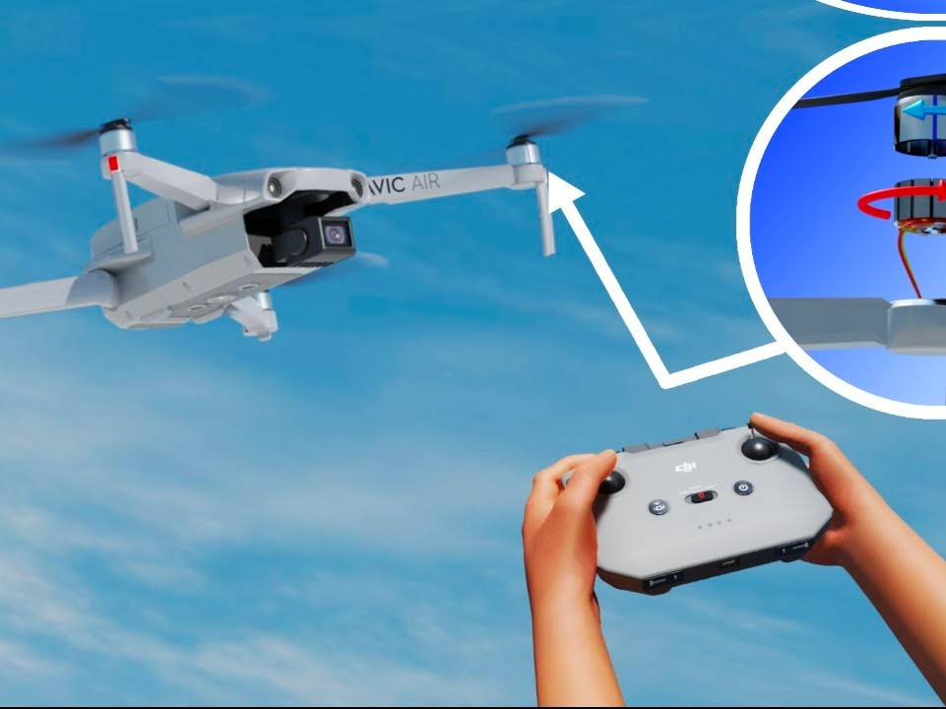
THANK YOU

